Slide 1
Break the Taboo about Mental Health
Melinda J. Baldwin, Ph.D., LCSW, Division Director
Division of Prevention, Traumatic Stress and Special Programs
Rob Vincent, MS.Ed
Associate Administrator for Alcohol Prevention and Treatment Policy
Substance Abuse and Mental Health Services Administration (SAMHSA)
May 2022
Notes:
I’d now to like introduce today’s presenter
INSERT NAME (INSERT BIO HERE)

Slide 2
Youth Mental Health in the United States
Risk Factors Contributing to Youth Mental Health Symptoms During the Pandemic (not an exhaustive list)
Having mental health challenges before the pandemic Living in an urban area or an area with more severe COVID-19 outbreaks Having parents or caregivers who were frontline workers Having parents or caregivers at elevated risk of burnout (for example, due to parenting demands) Being worried about COVID-19 Disruptions in routine, such as not seeing friends or going to school in person More adverse childhood experiences (ACEs) such as abuse, neglect, community violence, and discrimination More financial instability, food shortages, or housing instability Trauma, such as losing a family member or caregiver to COVID-19
General, U. S. (2021). Protecting Youth Mental Health: The U.S. Surgeon General's Advisory. Retrieved from https://www.hhs.gov/sites/default/files/surgeon-general-youth-mental-health-advisory.pdf
Administration, S. A. (2020). Key Substance Use and Mental Health Indicators in the United States: Results from the 2020 National Survey on Drug Use and Health. Rockville, MD: Center for Behavioral Health Statistics and Quality. Retrieved from https://www.samhsa.gov/data/sites/default/files/reports/rpt35325/NSDUHFFRPDFWHTMLFiles2020/2020NSDUHFFR1PDFW102121.pdf
CDC (2022). Adolescent Behaviors and Experiences Survey (ABES). Center for Disease Control and Prevention. Retrieved from: https://www.cdc.gov/healthyyouth/data/abes/tables/summary.htm#MH
Notes:
As reported by the U.S. Surgeon General:
2009-2019, the proportion of high school students reporting persistent feelings of sadness or hopelessness increased by 40%;
Seriously considering attempting suicide increased by 36%
Creating a suicide plan increased by 44%.
2011-2015, youth psychiatric visits to emergency departments for depression, anxiety, and behavioral challenges increased by 28%.
2007-2018, suicide rates among youth ages 10-24 in the US increased by 57%
Early estimates from the National Center for Health Statistics suggest there were tragically more than 6,600 deaths by suicide among the 10-24 age group in 2020

Slide 3
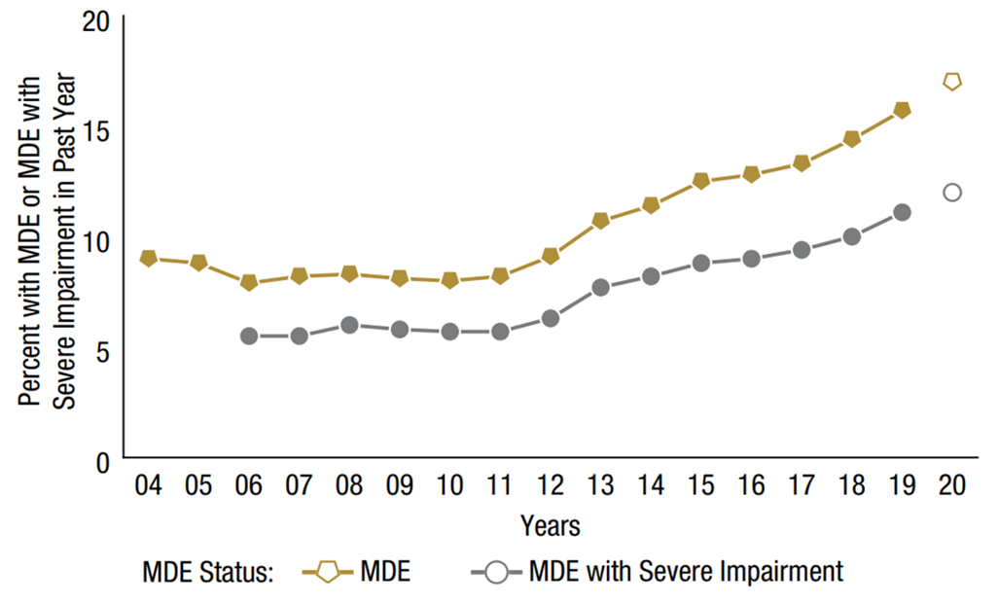
National Survey on Drug Use and Health (2020)
Major Depressive Episode (MDE) and MDE with Severe Impairment in the Past Year:
Among Youths Aged 12 to 17; 2004-2020
MDE
(2020)
17% or 4.1 million youth
MDE with Severe Impairment
(2020)
12% or 2.9 million youth
General, U. S. (2021). Protecting Youth Mental Health: The U.S. Surgeon General's Advisory. Retrieved from https://www.hhs.gov/sites/default/files/surgeon-general-youth-mental-health-advisory.pdf
Administration, S. A. (2020). Key Substance Use and Mental Health Indicators in the United States: Results from the 2020 National Survey on Drug Use and Health. Rockville, MD: Center for Behavioral Health Statistics and Quality. Retrieved from https://www.samhsa.gov/data/sites/default/files/reports/rpt35325/NSDUHFFRPDFWHTMLFiles2020/2020NSDUHFFR1PDFW102121.pdf
CDC (2022). Adolescent Behaviors and Experiences Survey (ABES). Center for Disease Control and Prevention. Retrieved from: https://www.cdc.gov/healthyyouth/data/abes/tables/summary.htm#MH
Notes:
Among adolescents aged 12 to 17 in 2020, 17.0 percent (or 4.1 million people) had a past year MDE. An estimated 12.0 percent of adolescents (or 2.9 million people) in 2020 had a past year MDE with severe impairment.
To protect the safety of field staff and survey participants during the COVID-19 pandemic, SAMHSA decided to suspend in-person NSDUH data collection on March 16, 2020. With administrative approval, a small-scale data collection effort was conducted from July 16 to 22, 2020, to assess the feasibility of safely resuming in-person data collection. The small-scale data collection effort was conducted in selected counties of two states where data collection was deemed safe based on state- and county-level COVID-19 metrics collected by Johns Hopkins University. For the remainder of 2020, however, it became clear that conventional in-person data collection would be severely limited due to the COVID-19 pandemic. To reduce the impact on NSDUH data collection due to the COVID-19 pandemic, SAMHSA approved the addition of web-based data collection on September 11, 2020. In Quarter 4 of 2020 (i.e., October to December), web-based screening and interviewing became the primary forms of NSDUH data collection. Conventional in-person data collection was carried out wherever it was considered safe to do so based on county- and state-level COVID-19 metrics.

Slide 4
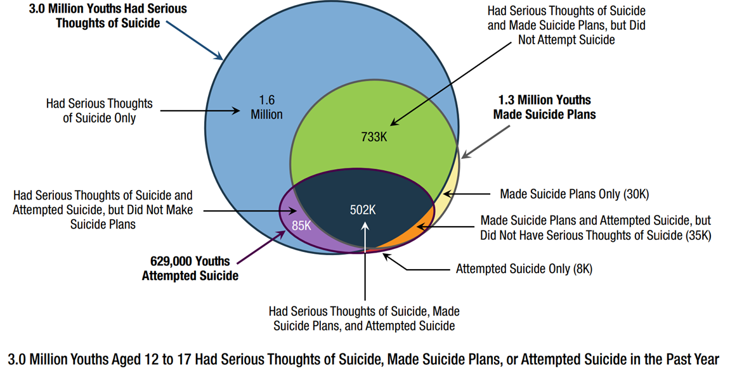
National Survey on Drug Use and Health (2020)
Youths Aged 12 to 17 with Serious Thoughts of Suicide, Suicide Plans, or Suicide
Attempts in the Past Year; 2020
General, U. S. (2021). Protecting Youth Mental Health: The U.S. Surgeon General's Advisory. Retrieved from https://www.hhs.gov/sites/default/files/surgeon-general-youth-mental-health-advisory.pdf
Administration, S. A. (2020). Key Substance Use and Mental Health Indicators in the United States: Results from the 2020 National Survey on Drug Use and Health. Rockville, MD: Center for Behavioral Health Statistics and Quality. Retrieved from https://www.samhsa.gov/data/sites/default/files/reports/rpt35325/NSDUHFFRPDFWHTMLFiles2020/2020NSDUHFFR1PDFW102121.pdf
CDC (2022). Adolescent Behaviors and Experiences Survey (ABES). Center for Disease Control and Prevention. Retrieved from: https://www.cdc.gov/healthyyouth/data/abes/tables/summary.htm#MH
Notes:
NSDUH Data; 2020 Report:
Among adolescents aged 12 to 17 in 2020, 12.0 percent (or 3.0 million people) had serious thoughts of suicide, 5.3 percent (or 1.3 million people) made a suicide plan, and 2.5 percent (or 629,000 people) attempted suicide in the past year.
To protect the safety of field staff and survey participants during the COVID-19 pandemic, SAMHSA decided to suspend in-person NSDUH data collection on March 16, 2020. With administrative approval, a small-scale data collection effort was conducted from July 16 to 22, 2020, to assess the feasibility of safely resuming in-person data collection. The small-scale data collection effort was conducted in selected counties of two states where data collection was deemed safe based on state- and county-level COVID-19 metrics collected by Johns Hopkins University. For the remainder of 2020, however, it became clear that conventional in-person data collection would be severely limited due to the COVID-19 pandemic. To reduce the impact on NSDUH data collection due to the COVID-19 pandemic, SAMHSA approved the addition of web-based data collection on September 11, 2020. In Quarter 4 of 2020 (i.e., October to December), web-based screening and interviewing became the primary forms of NSDUH data collection. Conventional in-person data collection was carried out wherever it was considered safe to do so based on county- and state-level COVID-19 metrics.

Slide 5
Adolescent Behaviors and Experiences Survey (ABES)
More than 1 in 3 high school students experienced poor mental health during the pandemic and nearly half of students felt persistently sad or hopeless.
Female students and those who identify as LGBQ are experiencing disproportionate levels of poor mental health and suicide-related behaviors.
The range of impacts on youth’s daily lives was broad – including difficulties, family economic impacts, hunger, and abuse in the home.
More than half of students experienced emotional abuse in the home and more than 10% reported physical abuse in the home.
Lesbian, gay, and bisexual students were far more likely to report physical abuse.
Black students were most likely to report hunger, with nearly a third reporting that there was not enough food in their home during the pandemic.
General, U. S. (2021). Protecting Youth Mental Health: The U.S. Surgeon General's Advisory. Retrieved from https://www.hhs.gov/sites/default/files/surgeon-general-youth-mental-health-advisory.pdf
Administration, S. A. (2020). Key Substance Use and Mental Health Indicators in the United States: Results from the 2020 National Survey on Drug Use and Health. Rockville, MD: Center for Behavioral Health Statistics and Quality. Retrieved from https://www.samhsa.gov/data/sites/default/files/reports/rpt35325/NSDUHFFRPDFWHTMLFiles2020/2020NSDUHFFR1PDFW102121.pdf
CDC (2022). Adolescent Behaviors and Experiences Survey (ABES). Center for Disease Control and Prevention. Retrieved from: https://www.cdc.gov/healthyyouth/data/abes/tables/summary.htm#MH
Notes:
As reported by the U.S. Surgeon General:
2009-2019, the proportion of high school students reporting persistent feelings of sadness or hopelessness increased by 40%;
Seriously considering attempting suicide increased by 36%
Creating a suicide plan increased by 44%.
2011-2015, youth psychiatric visits to emergency departments for depression, anxiety, and behavioral challenges increased by 28%.
2007-2018, suicide rates among youth ages 10-24 in the US increased by 57%
Early estimates from the National Center for Health Statistics suggest there were tragically more than 6,600 deaths by suicide among the 10-24 age group in 2020

Slide 6
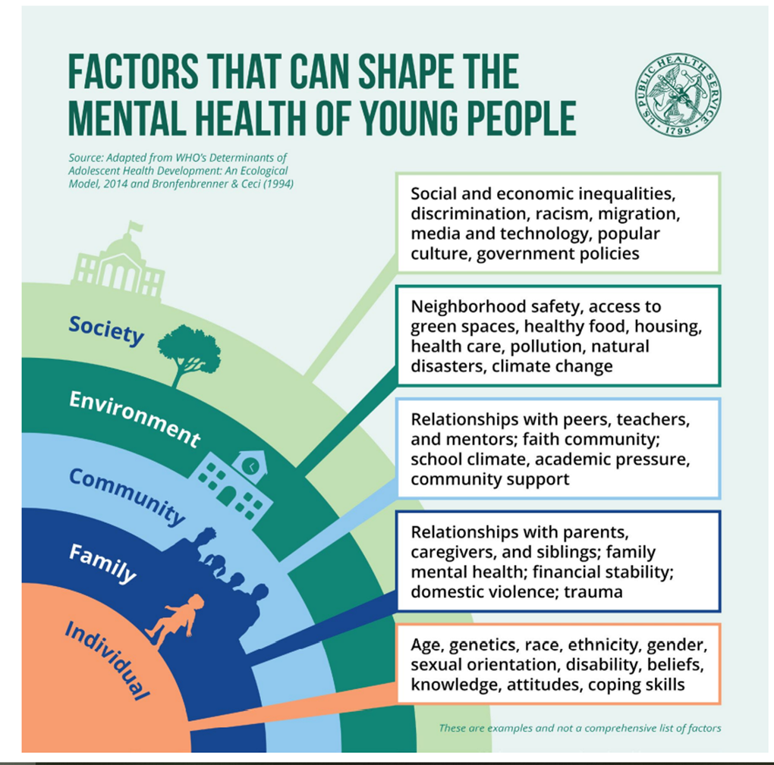
Factors Impacting Youth Mental Health (2021)
Relationships with parents, caregivers, siblings; family mental health; financial stability; domestic violence, trauma
General, U. S. (2021). Protecting Youth Mental Health: The U.S. Surgeon General's Advisory. Retrieved from https://www.hhs.gov/sites/default/files/surgeon-general-youth-mental-health-advisory.pdf
Administration, S. A. (2020). Key Substance Use and Mental Health Indicators in the United States: Results from the 2020 National Survey on Drug Use and Health. Rockville, MD: Center for Behavioral Health Statistics and Quality. Retrieved from https://www.samhsa.gov/data/sites/default/files/reports/rpt35325/NSDUHFFRPDFWHTMLFiles2020/2020NSDUHFFR1PDFW102121.pdf
CDC (2022). Adolescent Behaviors and Experiences Survey (ABES). Center for Disease Control and Prevention. Retrieved from: https://www.cdc.gov/healthyyouth/data/abes/tables/summary.htm#MH

Slide 7
What is SAMHSA’s role in addressing the risk factors and promoting the protective factors impacting youth well-being?

Slide 8
President’s Strategy to Address Our National Mental Health Crisis
Strengthen System Capacity
Invest in proven programs that bring providers into behavioral health.
Pilot new approaches to train a diverse group of paraprofessionals.
Build a national certification program for peer specialists.
Promote the mental well-being of our frontline health workforce.
Launch the “988” crisis response line and strengthen community-based crisis response.
Expand the availability of evidence-based community mental health services.
Invest in research on new practice models.
Connect Americans to Care
Expand and strengthen parity.
Integrate mental health and substance use treatment into primary care settings.
Improve veterans’ access to same-day mental health care.
Expand access to tele- and virtual mental health care options.
Expand access to mental health support in schools and colleges and universities.
Embed and co-locate mental health and substance use providers into community-based settings.
Increase behavioral health navigation resources.
Support Americans by Creating Healthy Environments
Strengthen children’s privacy and ban targeted advertising for children online.
Institute stronger online protections for young people, including prioritizing safety by design standards and practices for online platforms, products, and services.
Stop discriminatory algorithmic decision-making that limits opportunities for young Americans.
Invest in research on social media’s mental harms.
Expand early childhood and school-based intervention services and supports.
Set students up for success.
Increase mental health resources for justice-involved populations.
Train social and human services professionals in basic mental health skills.
The White House (2022). FACT SHEET: President Biden to Announce Strategy to Address Our National Mental Health Crisis, As Part of Unity Agenda in his First State of the Union The White House. Retrieved from: https://www.whitehouse.gov/briefing-room/statements-releases/2022/03/01/fact-sheet-president-biden-to-announce-strategy-to-address-our-national-mental-health-crisis-as-part-of-unity-agenda-in-his-first-state-of-the-union/

Slide 9
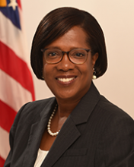
SAMHSA Priorities and Cross-Cutting Principles
2. Enhancing access to suicide prevention & crisis care
Equity
1. Preventing overdose
3. Promoting children & youth behavioral health
SAMHSA priorities
Workforce
Financing
5. Using performance measures, data, and evaluation
4. Integrating primary and behavioral healthcare
Miriam Delphin-Rittmon, Ph.D. Assistant Secretary for Mental Health and Substance Use
Recovery
9

Slide 10
SAMHSA’s Mental Health Investment
SAMHSA’s Behavioral Health Investment in Communities for Children, Youth, and Families $1.5 Billion | Substance Abuse Block Grant Prevention (20 percent set-aside) Treatment Mental Health Block Grant Programs of Regional and National Significance Strategic Prevention Framework-Partnerships for Success Sober Truth on Preventing Underage Drinking (STOP) Act Youth and Family TREE grant State Youth Implementation (SYT-I) grant Screening, Brief Intervention, and Referral To Treatment (SBIRT) Pregnant and Postpartum Women Programs (PPW & PPW Pilot) Children’s Mental Health Initiative (CMHI) Project Linking Action for Unmet Needs in Children’s Health (LAUNCH) National Child Trauma Stress Initiative (NCTSI) Children’s Mental Health Initiative (CMHI) Project Advancing Wellness and Resiliency in Education-State Education Agency (AWARE-SEA)

Slide 11
Project Advancing Wellness and Resiliency in Education (AWARE)
State Education Agency
The purpose of Project AWARE is to build or expand the capacity of State Educational Agencies, in partnership with State Mental Health Agencies (SMHAs) overseeing school-aged youth, and with three local education agencies (LEAs) to”
increase awareness of mental health issues among school-aged youth;
provide training for school personnel and other adults who interact with school-aged youth to detect and respond to mental health issues; and
connect school-aged youth who may have behavioral health issues (including serious emotional disturbance [SED] or serious mental illness [SMI]), and their families, to needed services. SAMHSA expects that this program will focus on partnerships and collaboration between state and local systems to promote the healthy development of school-aged youth and prevent youth violence.
Data Source: SAMHSA SPARS. IPP Performance Report. FY 2021. Retrieved on May 16, 2022.
Notes:
IPP Performance Report
AWARE Grant
Program
FY 2021
Approved and unapproved goals
Training includes WD2 + TR1
Referral includes R1 indicator

Slide 12
Project Advancing Wellness and Resiliency in Education (AWARE)
State Education Agency
Currently, there are 60 Project AWARE grantees across 38 states, 1 territory, and Washington D.C.
Project AWARE FY 2021 Total | FY 2021 Total
Number of policy changes completed | 269
Organizations that entered into a formal written agreement | 398
Individuals trained in mental health awareness | 226,037
Individuals screened for mental health services | 203,282
Individuals referred to mental health services | 49,468
Policies
Agreements
Trainings
Screenings
Referrals
Data Source: SAMHSA SPARS. IPP Performance Report. FY 2021. Retrieved on May 16, 2022.
Notes:
IPP Performance Report
MHAT Grant
Program
FY 2021
Approved and unapproved goals
Training includes WD2 + TR1
Referral includes R1 indicator

Slide 13
Mental Health Awareness Training (MHAT)
The purpose of MHAT is to:
Train individuals (e.g., school personnel, emergency first responders, law enforcement, veterans, armed services members and their families) to recognize the signs and symptoms of mental disorders, particularly serious mental illness (SMI) and/or serious emotional disturbances (SED);
Establish linkages with school- and/or community-based mental health agencies to refer individuals with the signs or symptoms of mental illness to appropriate services;
Train emergency services personnel, law enforcement, fire department personnel, veterans, and others to identify persons with a mental disorder and employ crisis de-escalation techniques; and
Educate individuals about resources that are available in the community for individuals with a mental disorder. It is expected that this program will prepare and train others on how to appropriately and safely respond to individuals with mental disorders, particularly individuals with SMI and/or SED.
Notes:
IPP Performance Report
MHAT Grant
Program
FY 2021
Approved and unapproved goals
Training includes WD2 + TR1
Referral includes R1 indicator

Slide 14
Mental Health Awareness Training (MHAT)
Currently, there are 182 MHAT grantees across 43 states, 2 territories, and Washington D.C.
MHAT FY 2021 Total | FY 2021 Total
Individuals trained in mental health awareness Trainings include: Mental Health First Aid (MHFA), Youth Mental Health First Aid (YMHFA), and Question, Persuade, Refer (QPR) and more | 47,764
Individuals referred to mental health services by the trainees | 49,468
Trainings
Referrals
Data Source: SAMHSA SPARS. IPP Performance Report. FY 2021. Retrieved on May 16, 2022.
Notes:
IPP Performance Report
MHAT Grant
Program
FY 2021
Approved and unapproved goals
Training includes WD2 + TR1
Referral includes R1 indicator

Slide 15
In 2018, SUPPORT for Patients Substance Use-Disorder Prevention that Promotes Opioid Recovery and Communities (SUPPORT for Patients and Communities) Act (P.L. 115-271) became law.
The Task Force charges 20 agencies (now 22) with soliciting input from stakeholders to inform the following activities and identifying, evaluating, and making recommendations regarding best practices with respect to children and families who have experienced trauma or are at risk of experiencing trauma AND ways in which federal agencies can better coordinate responses to families affected by substance use disorders and trauma.
Outcome Statement:
A national, trauma-informed, and coordinated federal strategy to build community capacity to identify, disseminate, foster, and refine evidence-based, evidence-informed, and best practices regarding childhood trauma to reduce the incidence of trauma, improve the response to families with exposure to substance misuse, enhance recognition of and response to trauma, strengthen resilience, and improve outcomes for children, youth, and families.

Slide 16
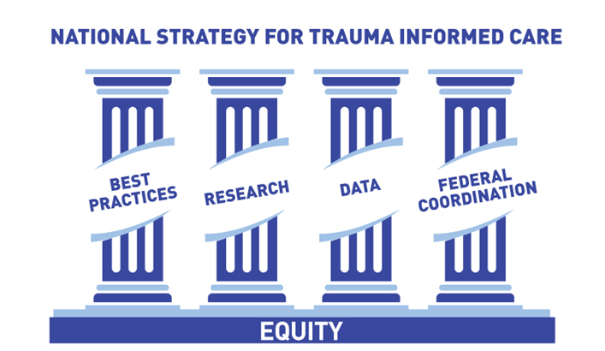
BEST PRACTICES
To identify and make recommendations on evidence-based and evidence-informed practices with respect to prevention of exposure to potentially traumatic events, identification of trauma-related behavioral health and other health needs, referral, and implementation of trauma-focused interventions and practices.
DATA
To coordinate data gathering, measurement, and tools used by programs and systems serving children and families impacted by trauma to better assess children, youth and family needs, and streamline services for, and enhance the care of children and families impacted by trauma.
RESEARCH
To evaluate and expand the knowledge base in the areas of preventing exposure to potentially traumatic events, identifying trauma related health, behavioral, academic, employment, and social needs, and interventions (individual and systems).
FEDERAL COORDINATION
To promote communication, coordination, and collaboration in the areas of trauma, trauma risk and resilience, and trauma-informed care across the federal government.

Slide 17
SAMHSA’s National Guidelines for Crisis Care – A Best Practice Toolkit
Advances national guidelines in crisis care within a toolkit that supports program design, development, implementation and continuous quality improvement efforts.
It is intended to help mental health authorities, agency administrators, service providers, state and local leaders think through and develop the structure of crisis systems.
Three essential elements:
Someone to Call
Someone to Respond
A Safe Place to Be
Notes:
Listening Sessions:
Family
Youth/young adults
SAMHSA Grantees
National Association of State Mental Health Program Directors (NASMHPD)
Expert Panel Meetings
Document – yes and…..

Slide 18
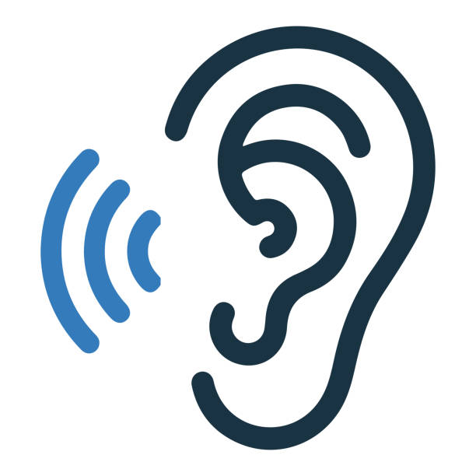
Listening Session Themes
Importance of family and youth peers
Focus should be on crisis prevention
Mobile response should be dispatched when family/youth requests
Need for response and services to be:
Equitable and accessible
Trauma-informed
Culturally appropriate
Need for staff to have:
Child development and family systems training
Knowledge of child and family serving systems and services
Specialized training, including youth/family engagement and de-escalation
Be connected with the community

Slide 19
Listening Session Themes – What We Learned
CONCERNS
Lack of a child and family crisis response system
Connection between 988 with local warm lines and response teams
Ability to meet increased requests for response
Rural communities - availability of services and ability to respond
Lack of community-based services – especially respite
Workforce shortage
Safety
Fiscal impact
Consent issues (both family and youth)
Need for child and family specific data collection and outcome measures
Need for coordination and partnerships with:
Schools, police, hospitals/emergency departments

Slide 20
What can families and caregivers do to address the risk factors and promote the protective factors impacting youth well-being?

Slide 21
Alcohol and Other Drug Facts
Among people 12 or older in 2020, 58.7% used tobacco, alcohol, or an illicit drug in the past month.
Alcohol and other drug use during the teen years can interfere with normal brain development and increase the risk of developing a use disorder.
Injury and violence related to drug use is one of the leading causes of death for teenagers.
Notes:
TALKING POINTS:
Please note that in all “Parents’ Night Out” materials, the terms “other substance use” and “other drug use” refer to the use of marijuana and other illicit drugs, prescription drug misuse and abuse, cigarette smoking, and vaping. Please be sure to explain this definition to participants at the outset of the presentation.
Source: Center for Behavioral Health Statistics and Quality. (2021). Results from the 2020 National Survey on Drug Use and Health: Detailed Tables. Rockville, MD: Substance Abuse and Mental Health Services Administration. Retrieved from https://www.samhsa.gov/data/report/2020-nsduh-annual-national-report

Slide 22
Alcohol and Drug Trends During COVID-19
Alcohol sales in stores went up 21% during the first 7 weeks of lockdown, while online sales more than doubled.
A California investigation found that delivery services are often delivering alcohol to youth under the age of 21.
U.S. retail marijuana sales rose 46% in 2020 and are expected to reach $37 billion by 2024.
Notes:
TALKING POINTS:
Delivery services are also used widely in retail marijuana sales and are difficult to police. Also, during the COVID-19 lockdown, marijuana was classified as “essential” in most states that have legal recreational use. There have also been concerns that because COVID-19 attacks the lungs, it is an especially serious threat to those who smoke or vape.
For those interested, sources can be shared at the end of the presentation.
Sources:
Nielsen. (2020, May 7). Rebalancing the ‘COVID-19 effect’ on alcohol sales. Retrieved from https://www.nielsen.com/us/en/insights/article/2020/rebalancing-the-covid-19-effect-on-alcohol-sales/
California Department of Alcoholic Beverage Control. (2020). Delivery of Alcoholic Beverages. Retrieved from https://www.abc.ca.gov/delivery-of-alcoholic-beverages/
BDSA. (2021, March 2). BDSA Reports Global Cannabis Sales Exceeded $21 Billion in 2020; Forecasts $55.9 Billion by 2026. Retrieved from https://www.globenewswire.com/news-release/2021/03/02/2185408/0/en/BDSA-Reports-Global-Cannabis-Sales-Exceeded-21-Billion-in-2020-Forecasts-55-9-Billion-by-2026.html
McVey, E. (2020, June 30). US retail marijuana sales on pace to rise 40% in 2020, near $37 billion by 2024. MJBizDaily. Retrieved from https://mjbizdaily.com/exclusive-us-retail-marijuana-sales-on-pace-to-rise-40-in-2020-near-37-billion-by-2023/
Volkow, N. (2020, April 6). COVID-19: Potential Implications for Individuals with Substance Use Disorders. National Institute on Drug Abuse. Retrieved from https://www.drugabuse.gov/about-nida/noras-blog/2020/04/covid-19-potential-implications-individuals-substance-use-disorders

Slide 23
Why Your Child May Start Drinking or Using Drugs
Stress—When children worry about things like grades, physical appearance, and fitting in, they may drink or use drugs to try to escape their problems.
Peer Pressure—Between ages 11 and 18 is when youth are most likely to be influenced by their friends and social media.
Transitions—Life events such as transitioning to high school or college, a breakup, moving, or their parents’ divorce can influence children to turn to alcohol or other drugs.
Notes:
TALKING POINTS:
Be aware of factors that may increase the risk of your child using alcohol and other drugs. Also, keep in mind that children can be influenced by viewing adult role models' alcohol- or drug-related behaviors.
Even though these factors may feel out of your control, there are things you can do to help your child:
Stress: Encourage your child to get involved in sports or other activities as a healthier way to cope with problems.
Peer Pressure: Help your child learn different ways to say “no.” Remind your child that real friends would not pressure him or her to drink or use other drugs.
Transitions: Reassure your child that things will get easier, and make sure he or she knows that drinking or using other drugs is not a solution.

Slide 24
Alcohol Use Increases with Age
Current, Binge, & Heavy Alcohol Use Among People Ages 12–20 in 2020
Center for Behavioral Health Statistics and Quality. (2021). 2020 National Survey on Drug Use and Health: Detailed Tables. Substance Abuse and Mental Health Services Administration, Rockville, MD.
Notes:
TALKING POINTS:
This chart illustrates alcohol use beginning at age 12. From ages 12 to 17, 8.2% of adolescents are using alcohol each month. From ages 18 to 25, that increases to 51.5%. During that time, binge drinking increases from 4.1% to 31.4%. Heavy drinking increases from 0.6% to 8.6%.
Source: Center for Behavioral Health Statistics and Quality. (2021). Results from the 2020 National Survey on Drug Use and Health: Detailed Tables. Rockville, MD: Substance Abuse and Mental Health Services Administration. Retrieved from https://www.samhsa.gov/data/report/2020-nsduh-annual-national-report

Slide 25
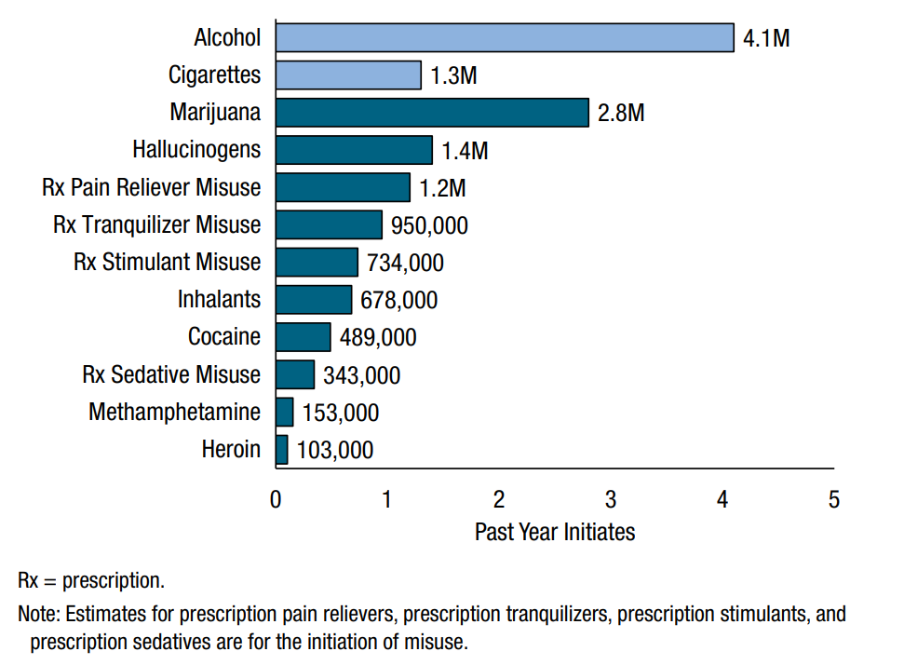
New Alcohol and Drug Users in One Year
Past Year Initiates of Substances: Among People Aged 12 or Older; 2020
Center for Behavioral Health Statistics and Quality. (2021). 2020 National Survey on Drug Use and Health: Detailed Tables. Substance Abuse and Mental Health Services Administration, Rockville, MD.
Notes:
TALKING POINTS:
This chart looks at how many people age 12 and over used alcohol and other drugs for the first time in 2020: 4.1 million people drank alcohol, 2.8 million used marijuana, and 1.3 million smoked cigarettes for the first time that year.
Source: Center for Behavioral Health Statistics and Quality. (2021). Results from the 2020 National Survey on Drug Use and Health: Detailed Tables. Rockville, MD: Substance Abuse and Mental Health Services Administration. Retrieved from https://www.samhsa.gov/data/report/2020-nsduh-annual-national-report

Slide 26
“Talk. They Hear You.” ®
A Parent-Focused National Media Campaign That Provides Tools & Resources to Help You.
26
Notes:
TALKING POINTS:
There are tools to help you have these conversations. “Talk. They Hear You.”, a national media campaign, provides parents and caregivers tools and resources to have conversations with their kids early and often to prevent underage drinking and other drug use. The campaign is run by the Substance Abuse and Mental Health Services Administration (SAMHSA) and was launched in 2013.
The “Talk. They Hear You.” campaign goals are to help parents “Get Informed,” “Be Prepared,” and “Take Action.”

Slide 27
“Talk. They Hear You.” ® Goals
#1
Increase parents’ awareness of the prevalence and risk of underage drinking and other drug use.
Equip parents with the knowledge, skills, and confidence to prevent underage drinking and other drug use.
Increase parents’ actions to prevent underage drinking and other drug use.
Get Informed
#2
Be Prepared
#3
Take
Action
Notes:
TALKING POINTS:
The three primary objectives for parents are to:
“Get Informed”
“Be Prepared”
“Take Action”

Slide 28
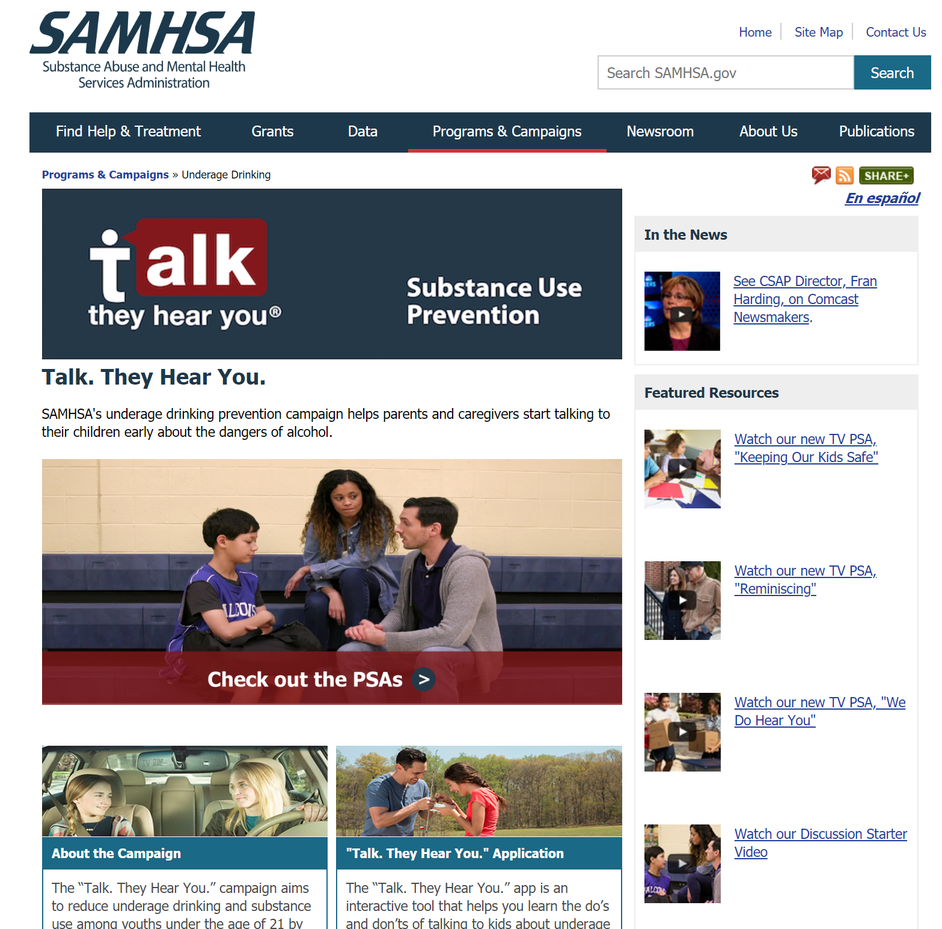
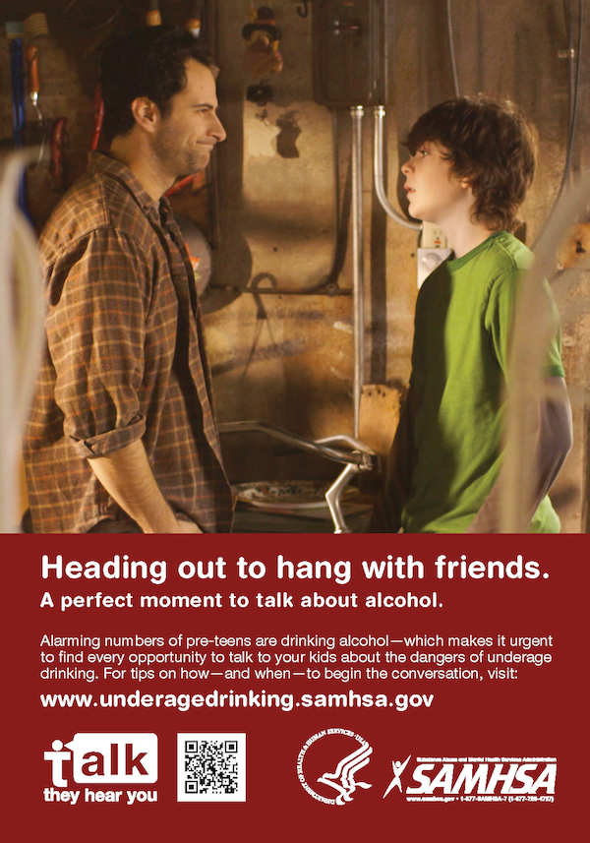
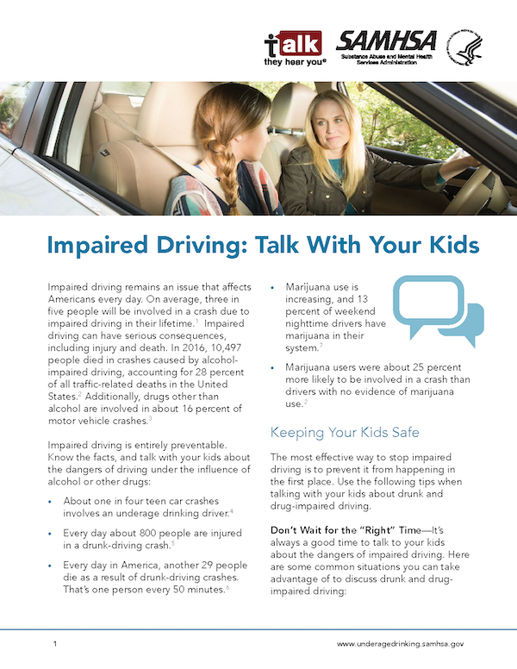
Tools to Help You: PSAs, Website, Fact Sheets, and More
Notes:
TALKING POINTS:
The “Talk. They Hear You.” campaign products include TV, radio, and print public service announcements (PSAs); a campaign website (www.talktheyhearyou.samhsa.gov); fact sheets; brochures and infographics; posters; postcards; and a mobile application. These materials show parents using everyday opportunities to talk with their children about alcohol and other drugs and include tools to help parents start these conversations with their own children.
Resources include:
Fact sheets on topics like “how to tell if your child is drinking” and “answering the tough questions.”
Brochures and infographics with in-depth information on alcohol and other drugs, like marijuana and opioids.
More print, TV, and radio PSAs that show everyday opportunities to talk with children about alcohol and other drugs.
All campaign materials, including the PSAs, are housed on the campaign website and SAMHSA Store. Note that we’ve expanded the campaign to include other substances besides alcohol, and we are exploring options to update our website URL to reflect this change.

Slide 29
What You Say and How You Say It Matters!
Although it may not seem like it, research shows that young people really do listen to what their parents have to say about alcohol and other drug use.
Lots of little talks keep the lines of communication open and work better than one “big talk.”
Treating your children like a partner in the conversations and trying to imagine how they feel will help them really hear what you have to say.

Slide 30
5 Conversation Goals
1
Show you disapprove of underage drinking and other drug use.
2
Show you care about your children’s health, wellness, and success.
3
Show you’re a good source of information about alcohol and other drugs.
4
Show you’re paying attention and will try to keep them from
drinking and using drugs.
5
Build your children’s skills and strategies for avoiding alcohol and other drugs.
Notes:
PRESENTER’S NOTE:
Click through all five goals, giving participants time to absorb them one at a time, but remind them that you’ll be covering each in more detail.
TALKING POINTS:
Research suggests that one of the most important factors in healthy child development is a strong, open relationship with a parent. It is important to start talking with your children about alcohol and other drugs before they are exposed to them—as early as 9 years old.
Use these five conversation goals to help get you started, but remember to keep it low key. Don’t worry, you don’t have to get everything across in one talk! Plan to check in often with quick chats and keep the lines of communication open.

Slide 31
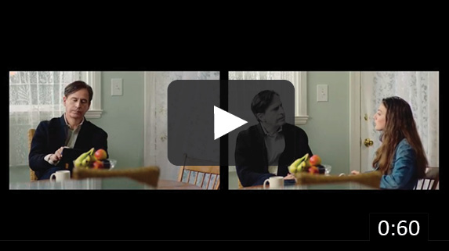
“Choices” PSA for Parents and Caregivers
Notes:
ROB
To further illustrate this influence, we include one of our latest public service announcements, “Choices” which was released this fall.
[PLAY PSA]

Slide 32
Taking Prevention Digital: New TTHY Products
“Talk. They Hear You.” Podcast
“What Parents Are Saying – Prevention Wisdom, Authenticity, and Empowerment”
(https://www.samhsa.gov/talk-they-hear-you/podcast)
“Parents’ Night Out” Educational Sessions
(https://www.samhsa.gov/talk-they-hear-you/parents-night-out)
Notes:
Second, “Talk. They Hear You.” recently launched its first podcast: “What Parents Are Saying – Prevention Wisdom, Authenticity, and Empowerment.” This new podcast provides a platform for parents and caregivers to get informed, be prepared, and take action by having open and honest conversations with their kids about substance use and mental health. Hosted by Debbie Berndt, Director of Parent Movement 2.0, the podcast will feature discussions with parents, caregivers, and nationally recognized experts lending their unique perspectives and experiences on how to navigate conversations around these important topics.
You can find it on many podcast hosting sites and applications as well as on our website! https://www.samhsa.gov/talk-they-hear-you/podcast
Third, “Talk. They Hear You.” just launched its “Parents’ Night Out.” These new educational sessions aim to inform parents and caregivers about the realities of underage drinking and other drug use, prepare them to talk with their kids about these issues, and motivate them to start these important conversations.
The “Parents’ Night Out” materials are intended to be used for community implementation of interactive, facilitator-led sessions that can be held either virtually or in person. Comprehensive toolkits are available for download and include all materials needed to implement either a single one hour-long “Parents’ Night Out” session or a series of three one hour-long program sessions. The “Parents’ Night Out” toolkits contain everything you need to plan, prepare, and host an event(s) in your community.
“Parents’ Night Out” was created with feedback from the “Talk. They Hear You.” campaign’s community partners and refined through feedback from pilot presentations that occurred in early 2021.

Slide 33
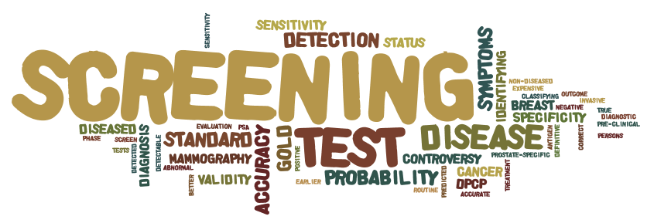
Screening as a Prevention Strategy
Early and periodic screening is widely recognized as one of the best ways to prevent the progression of more severe disease states in general and substance use specifically.
Screening often focuses on one disease at a time. However, this can create a high burden when trying to screen a larger population, which leads to multidimensional screening for multiple things at a time.
The results may identify strengths and areas to build on, early misuse that may only require brief intervention, and/or the need to refer for (hopefully early) intervention in one or more areas.
Notes:
Parents or guardians who have experienced the “Talk. They Hear You.” mobile app and want to screen their child for substance use problems or learn more about screening.
Service providers who work with youth (such as School Assistance Providers) who want to use the screener with their population.
Members of the public who navigate to the S4S website and want to learn more about screening or complete a screening for themselves.

Slide 34
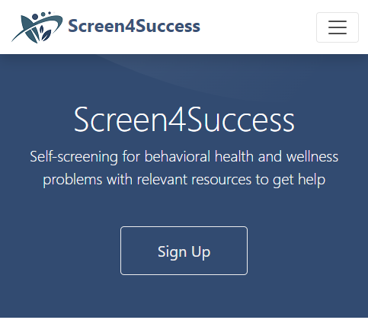
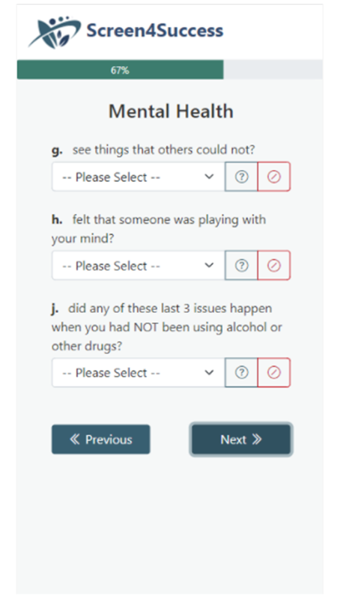
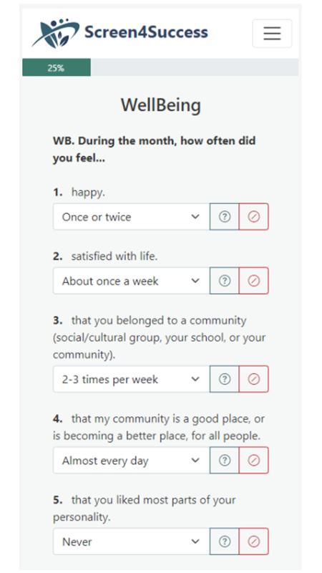
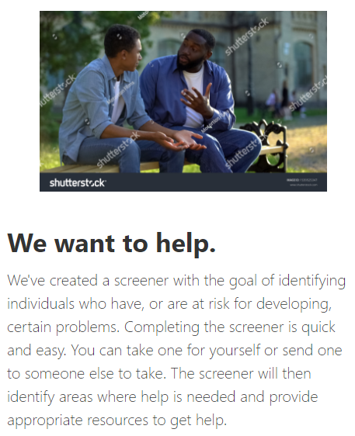
Further down is info about domains of screener, why screening is important, and how to find help.

Slide 35
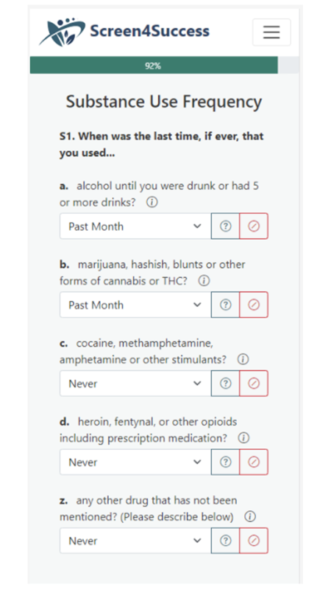
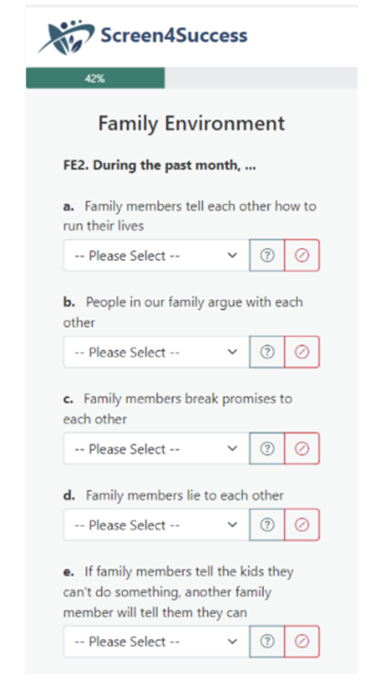
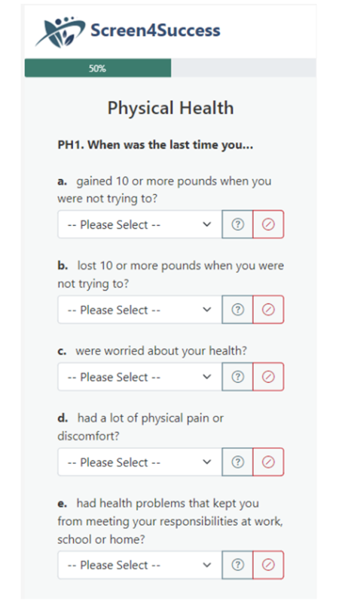
Screening as a Prevention Strategy
Screening often focuses on one disease at a time. However, this can create a high burden when trying to screen a larger population, which leads to multidimensional screening for multiple things at a time.
Notes:
S4S is a web-based cloud application that will provide users with a self-screening and referral management service.
S4S will allow users to answer questions about their feelings and behaviors related to wellness, family, health, mental health, and substance use and then receive immediate results and assistance to support self-referral.
S4S is a web-based cloud application that will provide users with a self-screening and referral management service.
S4S will allow users to answer questions about their feelings and behaviors related to wellness, family, health, mental health, and substance use and then receive immediate results and assistance to support self-referral.

Slide 36
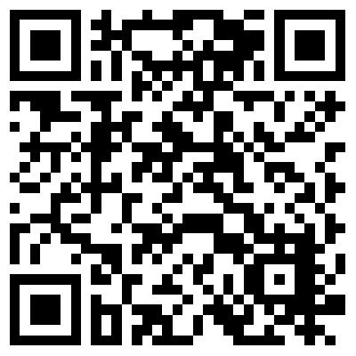
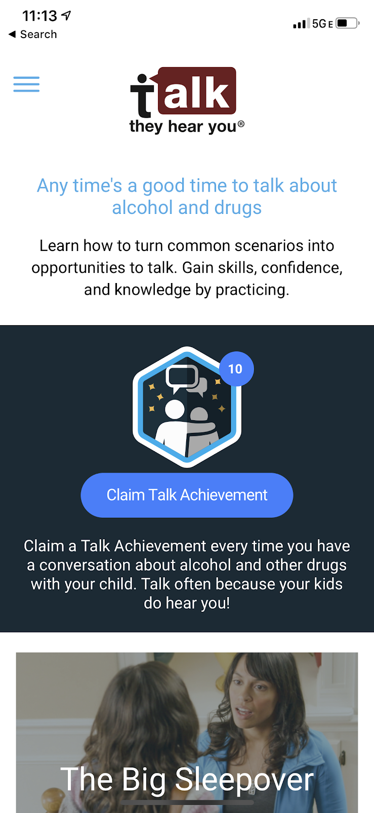
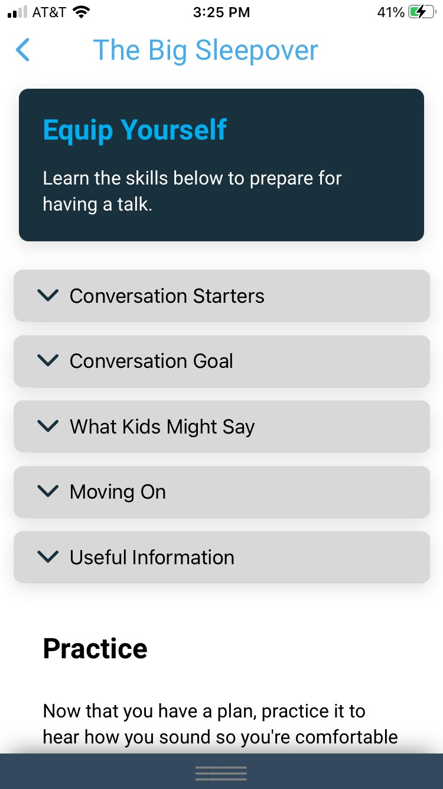
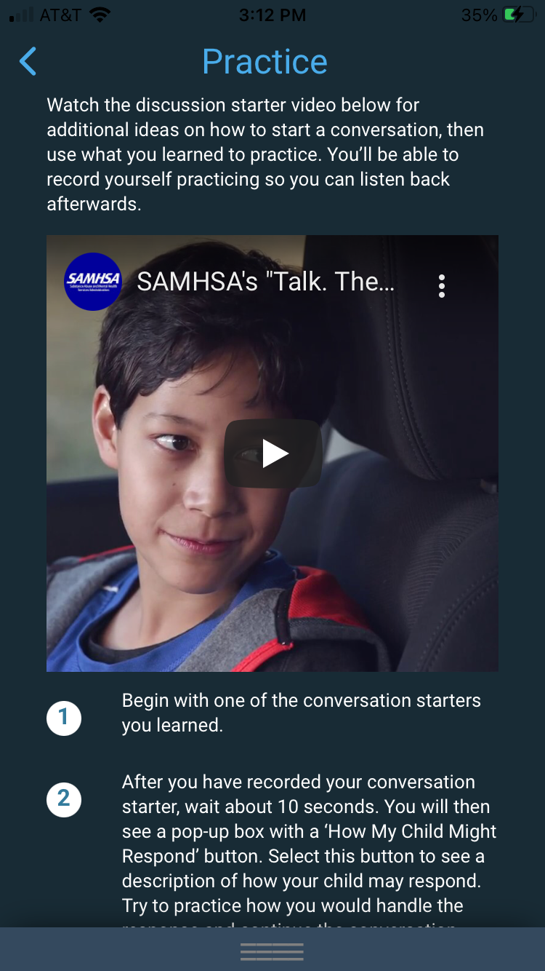
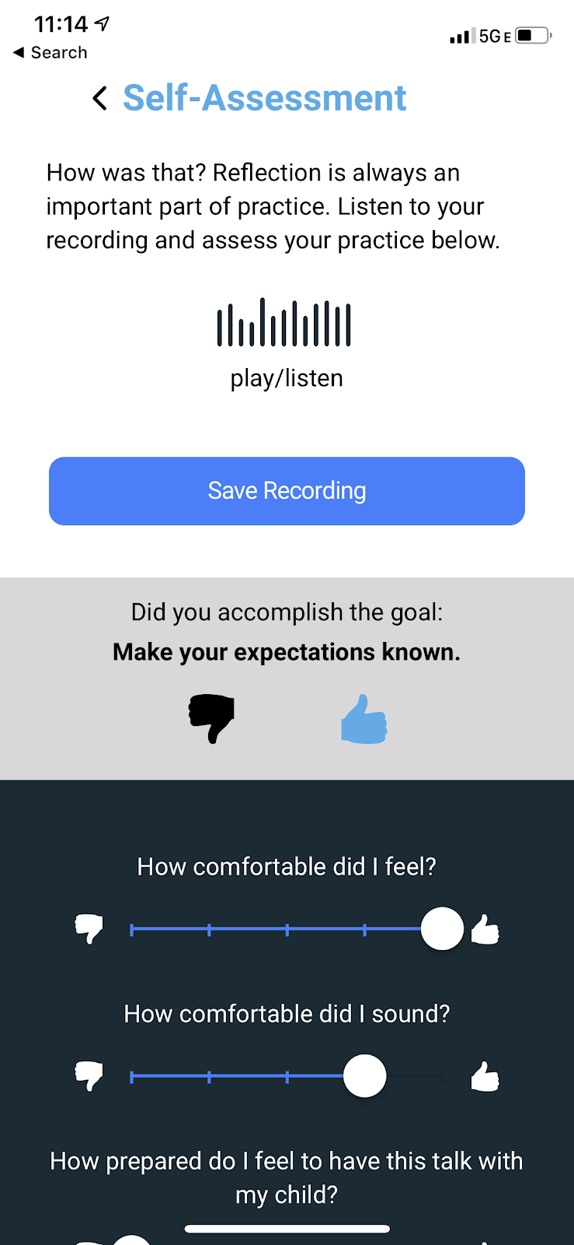
Taking Prevention Digital: Updated TTHY Products
“Talk. They Hear You.” Campaign Mobile App:
https://www.samhsa.gov/talk-they-hear-you/mobile-application
Notes:
“Talk. They Hear You.” has recently been focusing on ways to make it easier for parents and caregivers, schools and educators, and community partners to take prevention digital.
First, “Talk. They Hear You.” released the next iteration of its campaign mobile app. This app helps parents and caregivers learn how to turn everyday situations into opportunities to talk with their children about alcohol and other drugs. It also helps them gain the necessary skills, confidence, and knowledge to start and continue these important conversations as their kids get older by providing a safe and accessible medium to practice. The new mobile app’s content management system enables the campaign to promote featured campaign products for parents and caregivers, educators, and communities; make them available for download; and enable users to share these materials via their social media networks. It also enables the campaign to send push notifications to users to promote key campaign messaging and materials more frequently and strategically. The new mobile app replaces the previous version and is available to download for free on Android, iOS and Windows devices right now.

Slide 37
Thank You!
SAMHSA’s mission is to reduce the impact of substance abuse and mental illness on America’s communities.
Melinda J Baldwin, Ph.D, LCSW
Director, Division of Prevention, Traumatic Stress, & Special Programs
Melinda.Baldwin@samhsa.hhs.gov
Robert M. Vincent, MS.Ed
Associate Administrator for Alcohol Prevention and Treatment Policy
robert.vincent@samhsa.hhs.gov
www.samhsa.gov
1-877-SAMHSA-7 (1-877-726-4727) ● 1-800-487-4889 (TDD)

